Slide 1
Amazon Orders Data Analysis
Name : Keerthi .P
Tools used : Python| SQL | Power BI |Excel

Slide 2
Overview
Dataset : 128K orders
Objective :
Analyse customer orders and sales
Identify top-performing states
Understand category demand
Generate business insights

Slide 3
Tools & Workflow
Python – Cleaning
Excel – EDA
SQL – Analysis
Excel – Pivot tables & charts
Power BI – Dashboards

Slide 4
Data Cleaning Steps
Handling Missing Values
Remove Duplicates
Standardization Done
Outliers Treated

Slide 5
Data Cleaning
Before Cleaning
After Cleaning
Category | size | Courier Status | amount | Currency
Set Western Dress | 3XL L | Cancelled None | None 753.33 | None INR
Category | Size | Courier Status | amount | Currency
Set Western Dress | 3XL L | Cancelled Unknown | 305 753.33 | INR INR

Slide 6
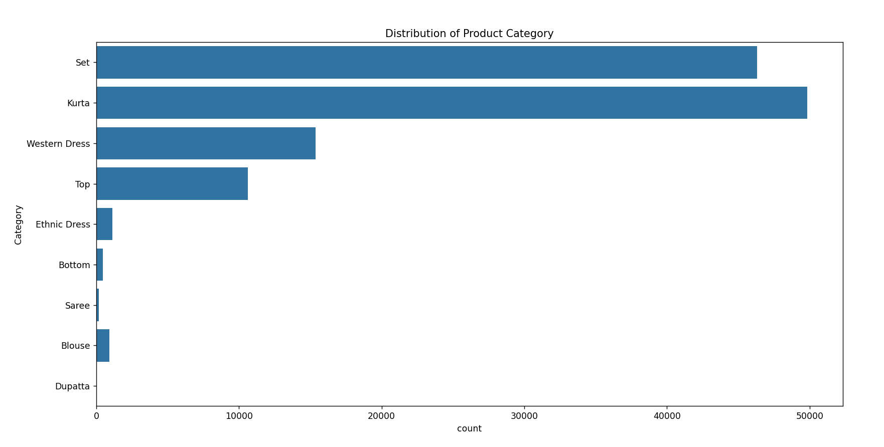
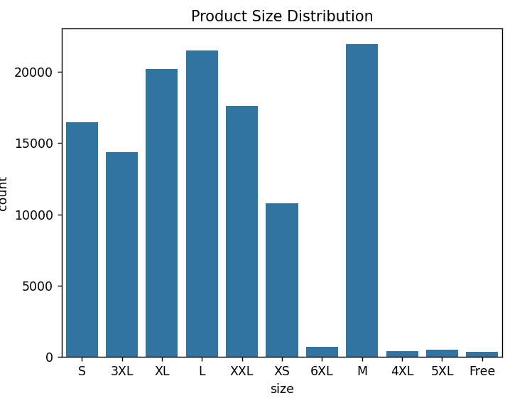
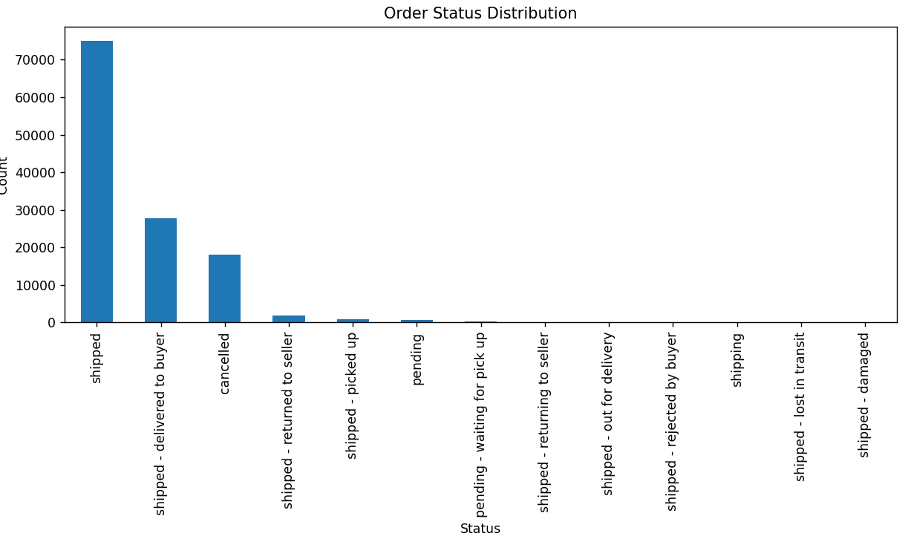
EDA Distribution by category, size & status

Slide 7
SQL Query : Top States
SELECT ship_state, SUM(Amount) AS total_sales
FROM amazon_orders
GROUP BY ship_state
ORDER BY total_sales desc
Limit 5;
Insight:
Maharashtra generates the highest sales revenue
Karnataka is the second top-performing state
Southern and western regions dominate sales

Slide 8
SQL Query : Category Analysis
SELECT Category, COUNT(*) AS orders FROM amazon_orders GROUP BY Category;
Insight:
Fashion category has the highest number of orders
Other categories contribute significantly less
Customer demand is highly concentrated in one category

Slide 9
EXCEL

Slide 10
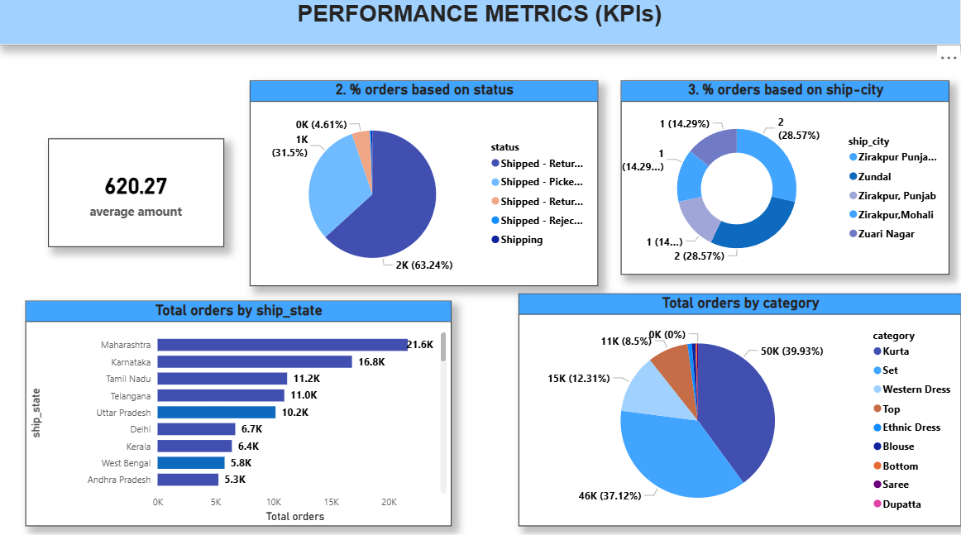
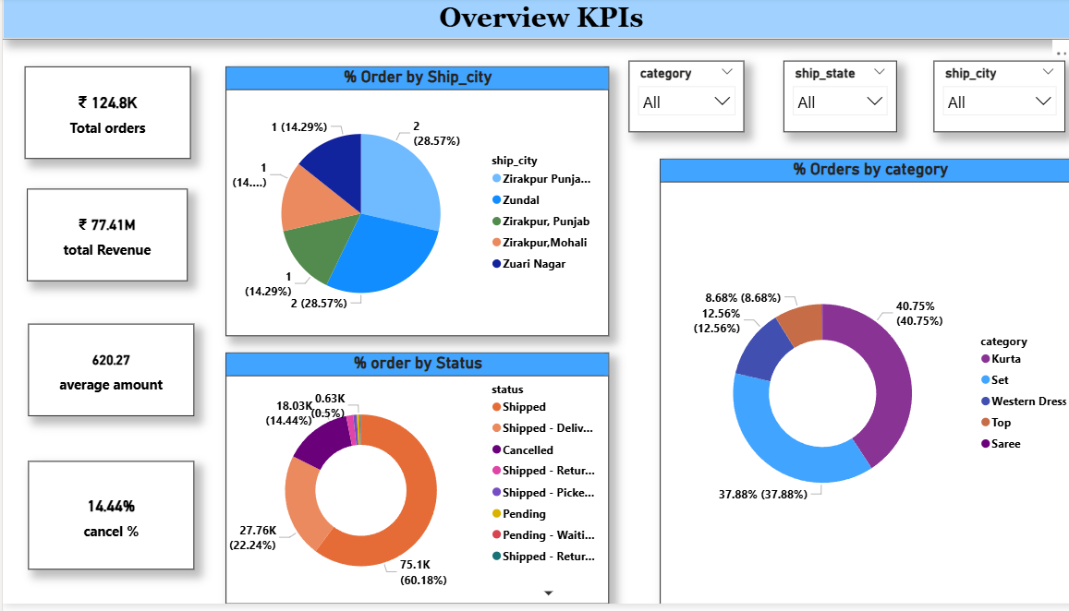
Power BI Report

Slide 11
Business Insights
Focus marketing on profitable customer segments.
Optimize discounts to protect margins.
Expand product lines in high‑demand categories.
Streamline operations to reduce cancellations.
Monitor costs regularly to keep finances under control.
Build customer trust by ensuring timely delivery, responsive service, and encouraging positive reviews.

Slide 12
Conclusion
The Amazon orders analysis shows that fashion products are in very high demand, sales heavily concentrated in a few key states such as Maharashtra and Karnataka. Customers consistently prefer fast, expedited shipping, which strongly influences their buying decisions and overall satisfaction. Seasonal trends and promotional offers also play a crucial role in increasing order volume and customer engagement. Furthermore, improving delivery efficiency and expanding reach in underperforming regions could unlock new growth opportunities. Overall, leveraging data-driven insights can help businesses optimize inventory, enhance customer experience, and maximize profitability.

Slide 13
Thank You

